Slide 1
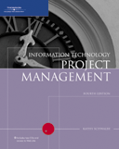
Chapter 9:
Project Human Resource Management
Information Technology Project Management,
Fourth Edition

Slide 2
Learning Objectives
Explain the importance of good human resource management on projects, including the current state and future implications of human resource management, especially on information technology projects.
Define project human resource management and understand its processes.
Summarize key concepts for managing people by understanding the theories of Abraham Maslow, Frederick Herzberg, David McClelland, and Douglas McGregor on motivation, H. J. Thamhain and D. L. Wilemon on influencing workers, and Stephen Covey on how people and teams can become more effective.

Slide 3
Organizational Planning
Involves identifying and documenting project roles, responsibilities, and reporting relationships.
Outputs include:
  Project organizational charts
  Staffing management plans
  Responsibility assignment matrixes
  Resource histograms

Slide 4
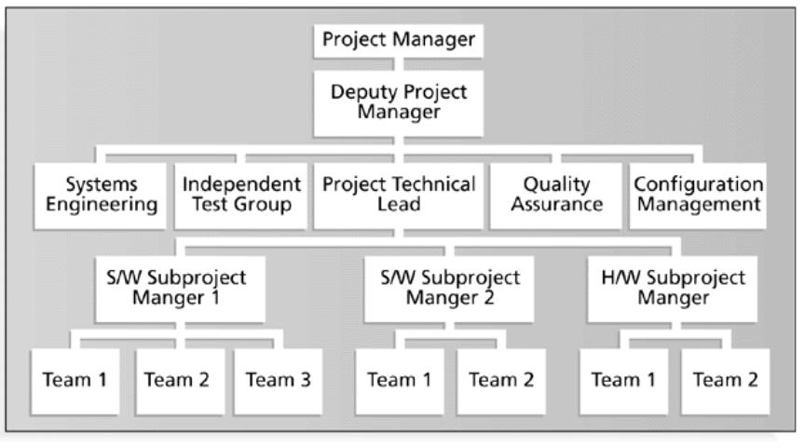
Figure 9-2. Sample Organizational Chart for a Large IT Project

Slide 5
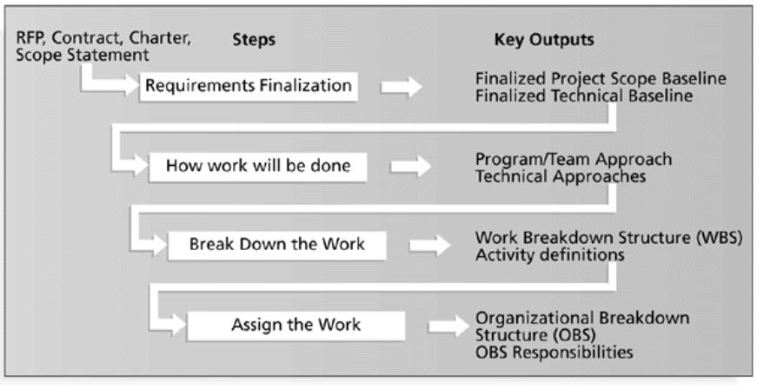
Figure 9-3. Work Definition and Assignment Process

Slide 6
Responsibility Assignment Matrixes
A responsibility assignment matrix (RAM) is a matrix that maps the work of the project, as described in the WBS, to the people responsible for performing the work, as described in the OBS.
Can be created in different ways to meet unique project needs.

Slide 7
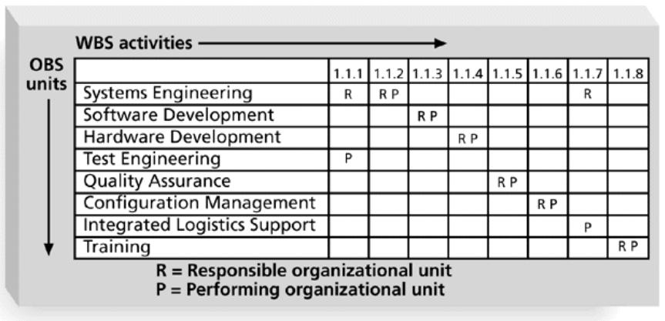
Figure 9-4. Sample Responsibility Assignment Matrix (RAM)

Slide 8
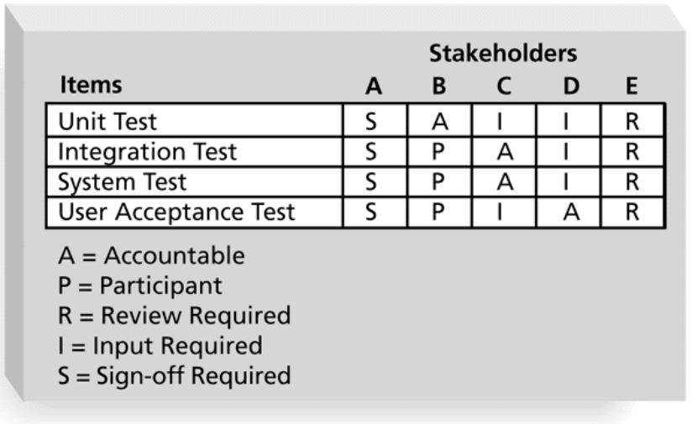
Figure 9-5. RAM Showing Stakeholder Roles

Slide 9
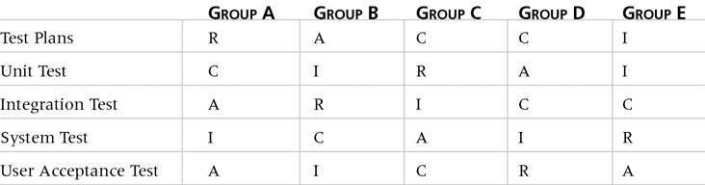
Table 9-1. Sample RACI Chart
R = Responsibility, only one R per task
A = Accountability
C = Consultation
I = Informed

Slide 10
Staffing Management Plans and Resource Histograms
A staffing management plan describes when and how people will be added to and taken off the project team.
A resource histogram is a column chart that shows the number of resources assigned to a project over time.

Slide 11
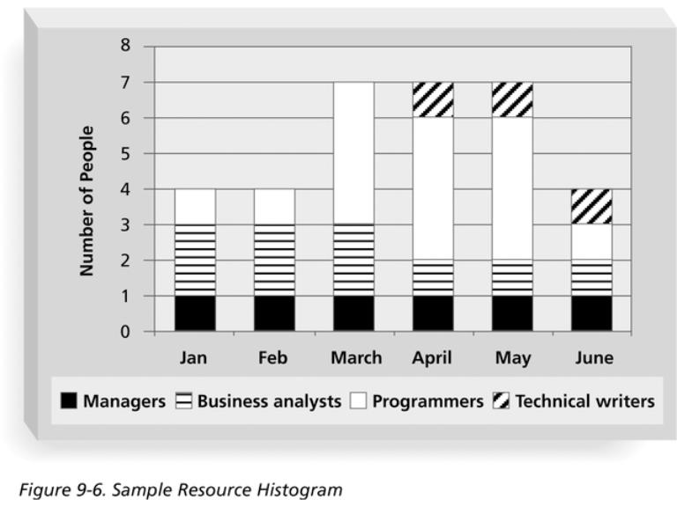
Figure 9-6. Sample Resource Histogram

Slide 12
Acquiring the Project Team
Acquiring qualified people for teams is crucial.
The project manager who is the smartest person on the team has done a poor job of recruiting!
Staffing plans and good hiring procedures are important, as are incentives for recruiting and retention.
  Some companies give their employees one dollar for every hour that a new person who they helped hire works.
  Some organizations allow people to work from home as an incentive.

Slide 13
Why People Leave Their Jobs
They feel they do not make a difference.
They do not get proper recognition.
They are not learning anything new or growing as a person.
They do not like their coworkers.
They want to earn more money.

Slide 14
Resource Loading
Resource loading refers to the amount of individual resources an existing schedule requires during specific time periods.
Helps project managers develop a general understanding of the demands a project will make on the organization’s resources and individual people’s schedules.
Overallocation means more resources than are available are assigned to perform work at a given time.

Slide 15
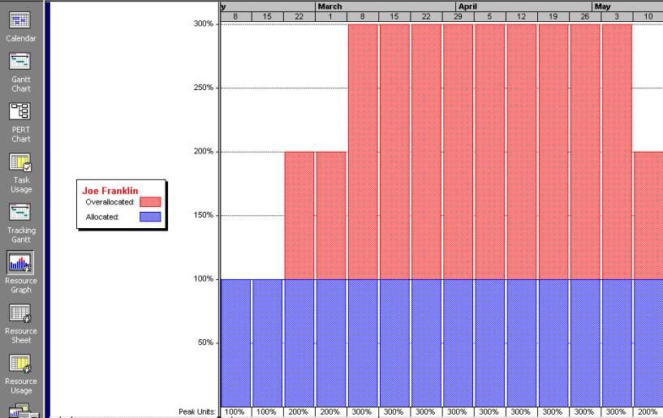
Figure 9-7. Sample Histogram Showing an Overallocated Individual
What’s wrong with this picture? Assume 100 percent means Joe is working eight hours per day.

Slide 16
Resource Leveling
Resource leveling is a technique for resolving resource conflicts by delaying tasks.
The main purpose of resource leveling is to create a smoother distribution of resource use and reduce overallocation.

Slide 17
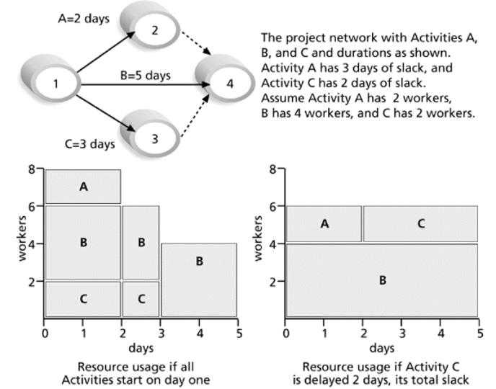
Figure 9-8. Resource Leveling Example

Slide 18
Benefits of Resource Leveling
When resources are used on a more constant basis, they require less management.
It may enable project managers to use a just-in-time inventory type of policy for using subcontractors or other expensive resources.
It results in fewer problems for project personnel and the accounting department.
It often improves morale.

Slide 19
Developing the Project Team
The main goal of team development is to help people work together more effectively to improve project performance.
It takes teamwork to successfully complete most projects.

Slide 20
Tuckman Model of Team Development
Forming
Storming
Norming
Performing
Adjourning

Slide 21
Training
Training can help people understand themselves and each other, and understand how to work better in teams.
Team building activities include:
  Physical challenges
  Psychological preference indicator tools

Slide 22
Myers-Briggs Type Indicator (MBTI)
MBTI is a popular tool for determining personality preferences and helping teammates understand each other.
Four dimensions include:
  Extrovert/Introvert (E/I)
  Sensation/Intuition (S/N)
  Thinking/Feeling (T/F)
  Judgment/Perception (J/P)
NTs, or rationals, are attracted to technology fields.
IT people vary most from the general population in their tendency to not be extroverted or sensing.

Slide 23
Wideman and Shenhar’s Views on MBTI and Project Management*
Most suited for project leadership:
  100 percent: INTJ, ENTJ, ISTJ, ESTJ
  50 percent: INTP, ENTP, ENFP, ENFJ
Best suited as followers:
  100 percent: INFJ, ISFJ
  50 percent: INTP, ENTP, ENFP, ENFJ, ESFJ
Not suited for project work:
  100 percent: INFP, ISFP, ESFP, ISTP
  50 percent: ENFP, ESTP
  https://medium.com/@dolly19304/personality-prediction-using-myers-briggs-type-indicator-56888416e87c
*Wideman, R. Max and Aaron J. Shenhar, “Professional and Personal Development: A Practical Approach to Education and Training,” Project Management for Business Professionals, edited by Joan Knutson, 2001, p. 375.

Slide 24
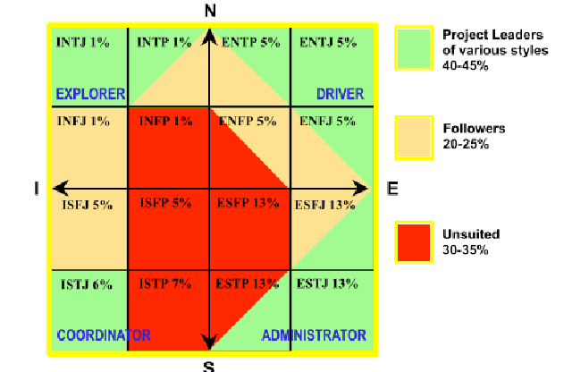
MBTI and Suitability to Project Work*
What do you think about these views?
*Wideman, R. Max. “Project Teamwork, Personality Profiles and the Population at Large: Do we
have enough of the right kind of people?” (http://www.maxwideman.com/papers/profiles/profiles.pdf ).

Slide 25
Social Styles Profile
People are perceived as behaving primarily in one of four zones, based on their assertiveness and responsiveness:
  Drivers
  Expressives
  Analyticals
  Amiables
People on opposite corners (drivers and amiables, analyticals and expressives) may have difficulty getting along.

Slide 26
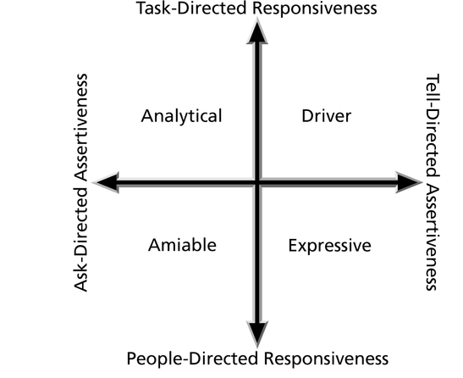
Figure 9-9. Social Styles

Slide 27
Reward and Recognition Systems
Team-based reward and recognition systems can promote teamwork.
Focus on rewarding teams for achieving specific goals.
Allow time for team members to mentor and help each other to meet project goals and develop human resources.

Slide 28
Managing the Project Team
Project managers must lead their teams in performing various project activities.
After assessing team performance and related information, the project manager must decide:
  If changes should be requested to the project.
  If corrective or preventive actions should be recommended.
  If updates are needed to the project management plan or organizational process assets.

Slide 29
Tools and Techniques for Managing Project Teams
Observation and conversation
Project performance appraisals
Conflict management
Issue logs

Slide 30
General Advice on Teams
Be patient and kind with your team.
Fix the problem instead of blaming people.
Establish regular, effective meetings.
Allow time for teams to go through the basic team-building stages.
Limit the size of work teams to three to seven members.

Slide 31
General Advice on Teams (cont’d)
Plan some social activities to help project team members and other stakeholders get to know each other better.
Stress team identity.
Nurture team members and encourage them to help each other.
Take additional actions to work with virtual team members.

Slide 32
Using Software to Assist in Human Resource Management
Software can help produce RAMS and resource histograms.
By using project management software for human resource management, you can:
  Assign resources.
  Identify potential resource shortages or underutilization.
  Level resources.

Slide 33
Project Resource Management Involves Much More Than Using Software
Project managers must:
  Treat people with consideration and respect.
  Understand what motivates people.
  Communicate carefully with people.
Focus on your goal of enabling project team members to deliver their best work.

Slide 34
Chapter Summary
Project human resource management includes the processes required to make the most effective use of the people involved with a project.
Main processes include:
  Human resource planning
  Acquiring the project team
  Developing the project team
  Managing the project team

